Slide 1
Andi Apartman

Slide 2
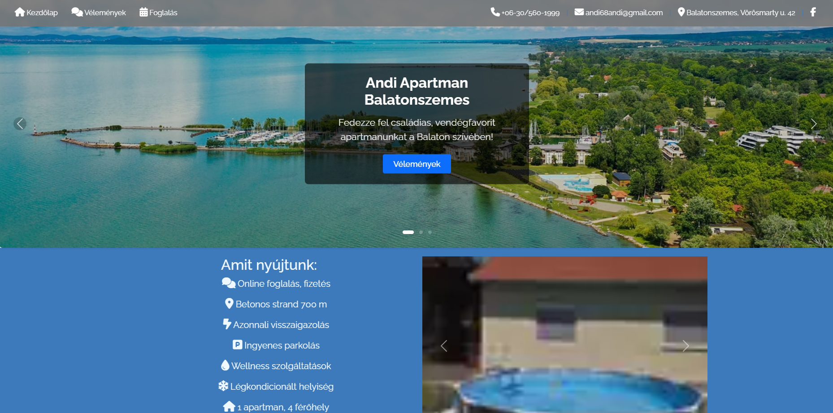
- Áron’s parents apartment
- Fully working website, with online reserving
- Admin system directly built to the owner’s needs

Slide 3
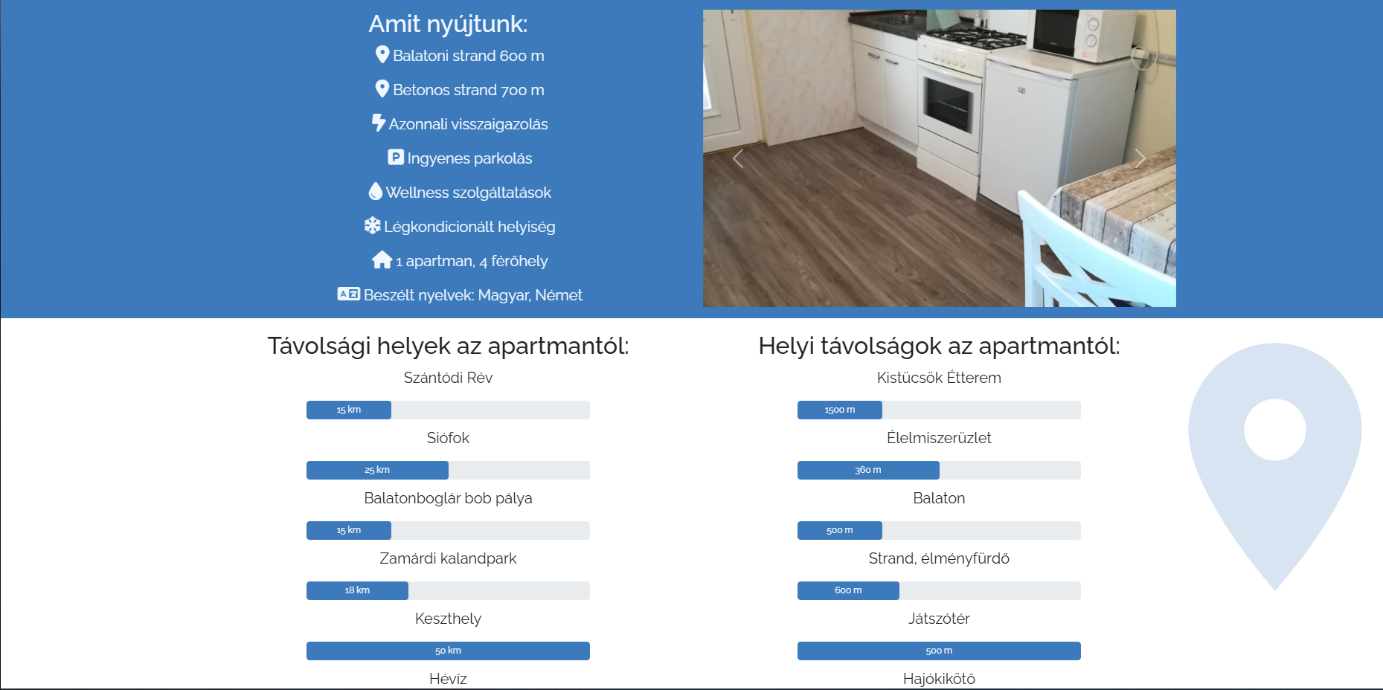
The website:
- Informations about the apartment building
- Nearby point of interests
- A lot CSS, JavaScript animations to make the website more alive

Slide 4
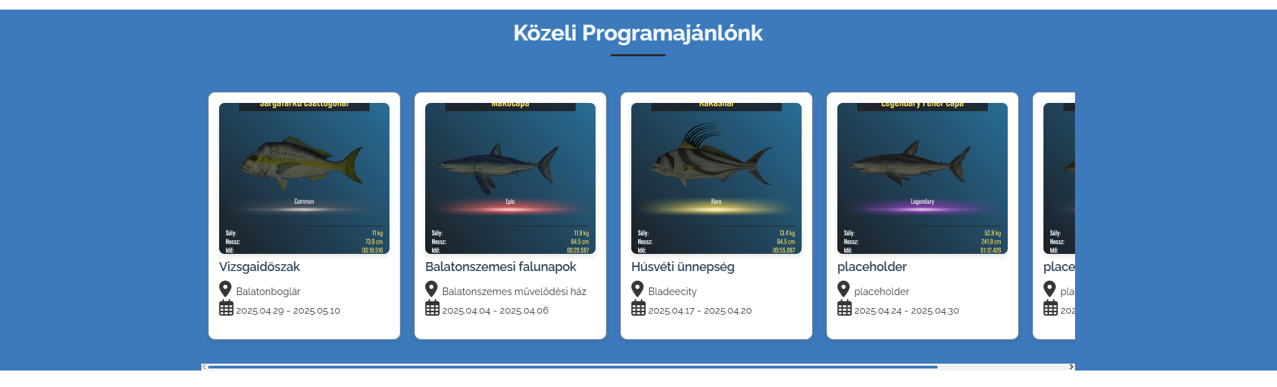
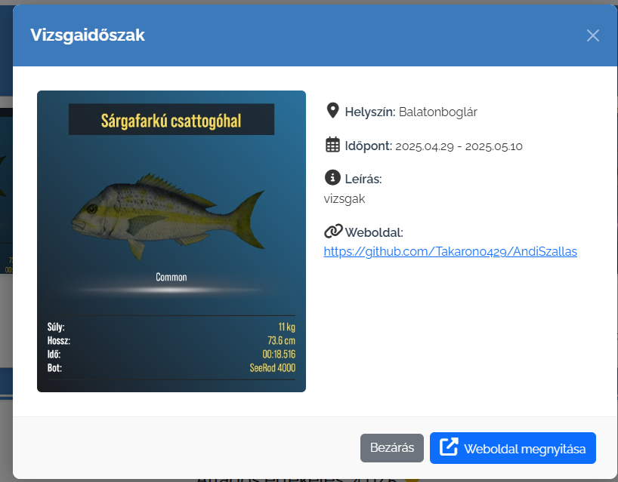
Nearby Programs
Datas provided by the admin interface
By clicking on the selected program, every single information is available on the popup menu

Slide 5
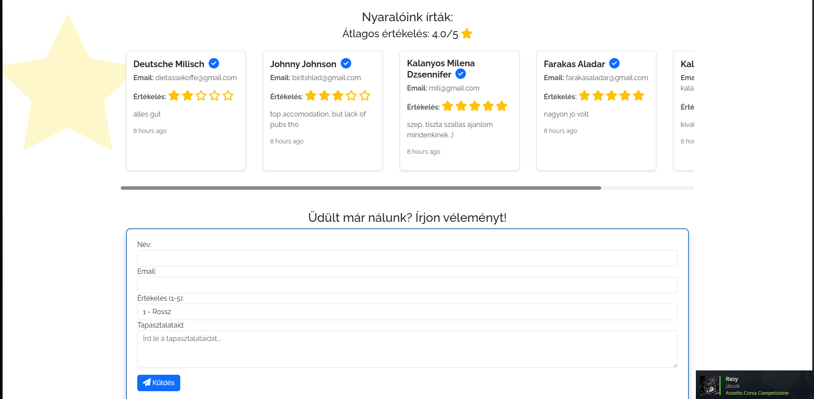
Opinions
You can write your opinion on the website, handled by a database.
New opinions needs to get approved first in the admin panel to show up on the site

Slide 6
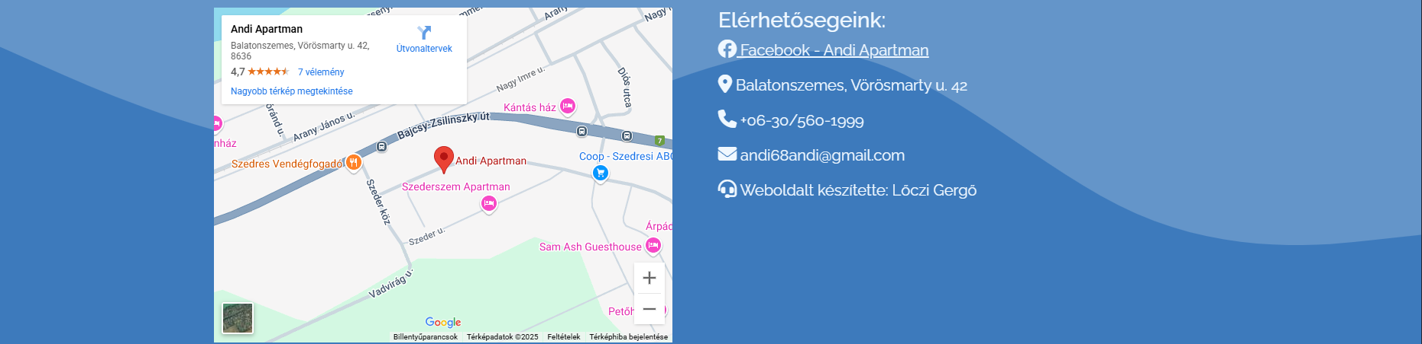
Footer
Google maps embed
Informations about the apartment

Slide 7
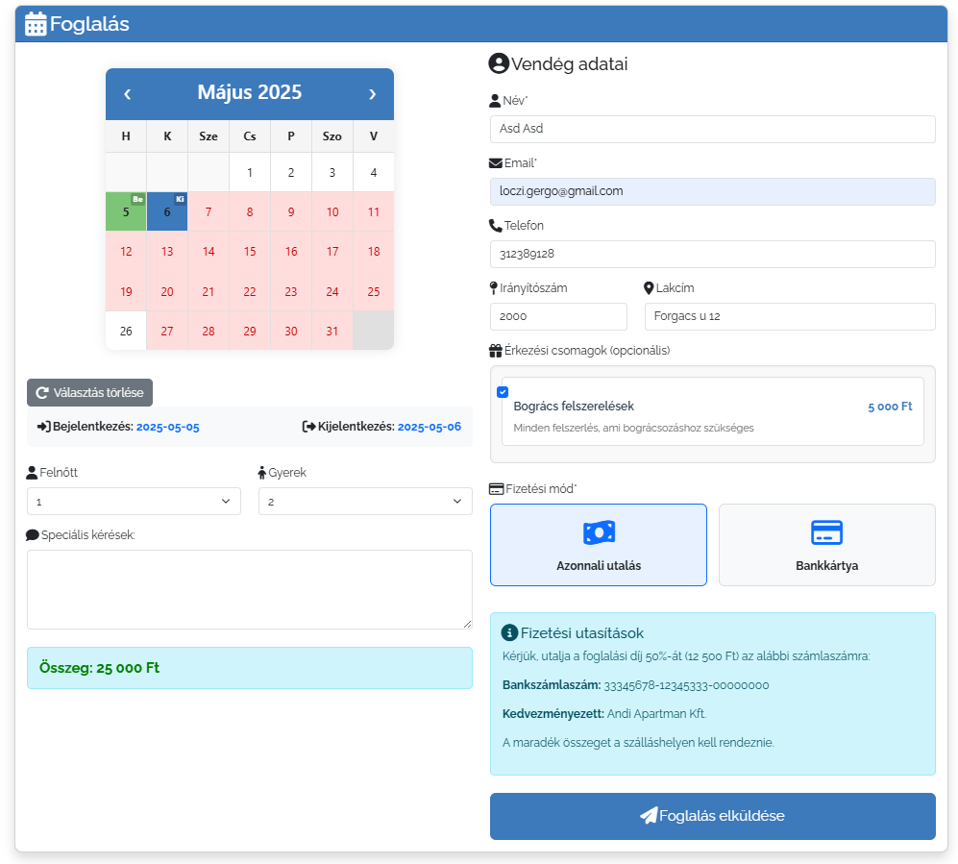
Reserving site
Calendar disables selecting already reserved dates
Optional packages
2 different payment method

Slide 8
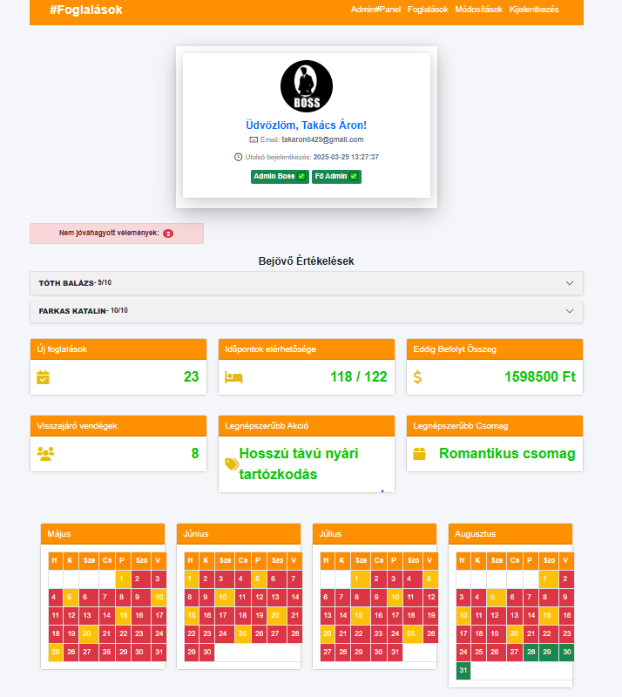
.
Admin panel
Review Management
Lists guest reviews and ratings.
Admin can approve or delete reviews, before it reveals on the Main page
Booking and Availability
Displays new reservations.
Shows available and booked dates.
Financial and Guest Data
-Booking Callender

Slide 9
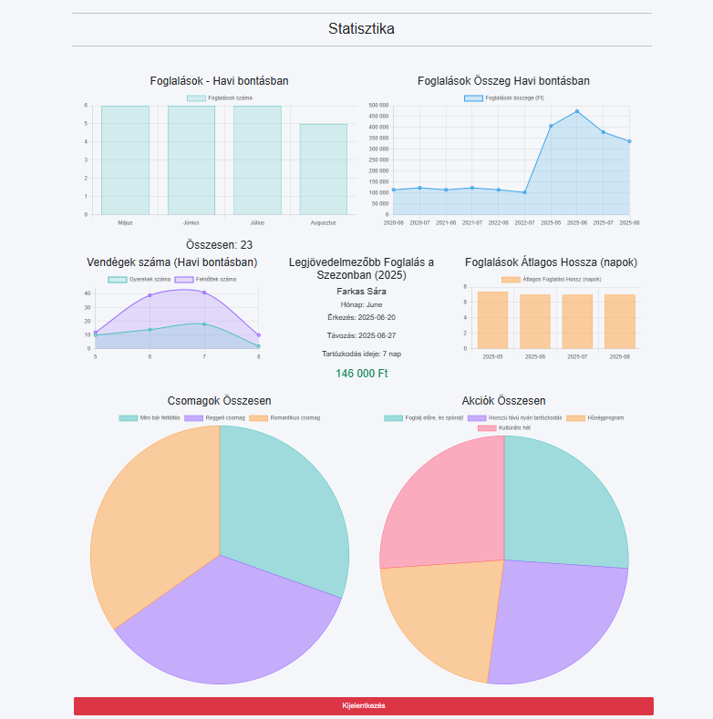
Booking Statistics
Monthly Reservations: Tracks the number of bookings per month.
Revenue Analysis: Displays total revenue generated from reservations.
Guest Count: Shows the number of guests staying each month.
Top-Grossing Booking (2025): Highlights the most profitable reservation,.
Average Stay Duration: Analyzes how long guests typically stay.
Package & Discount Insights: Monitors the total number of package deals and discounts used.
This data helps optimize pricing, improve guest experience, and plan future marketing strategies.

Slide 10
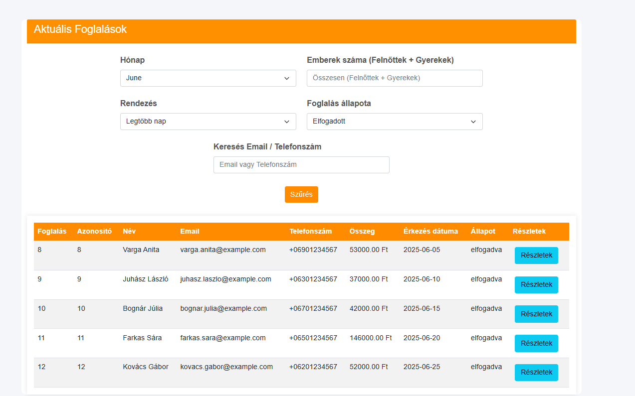
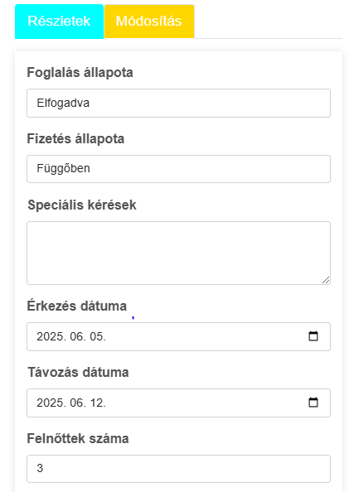
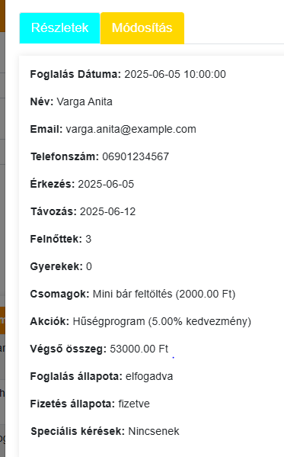
Manage Bookings – You can see and edit or Update the reservations..
Check Guest Details – You can view guest names, contact information, and booking history.
Manage Payments – You can track payments and refunds.
Sort- days, money, people numb, email, phone number etc…

Slide 11
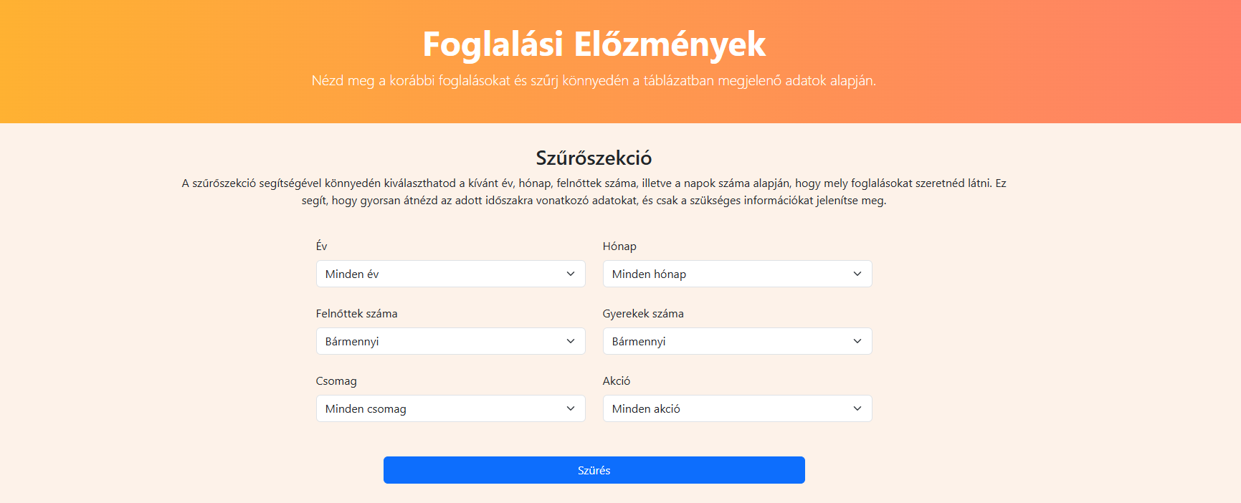
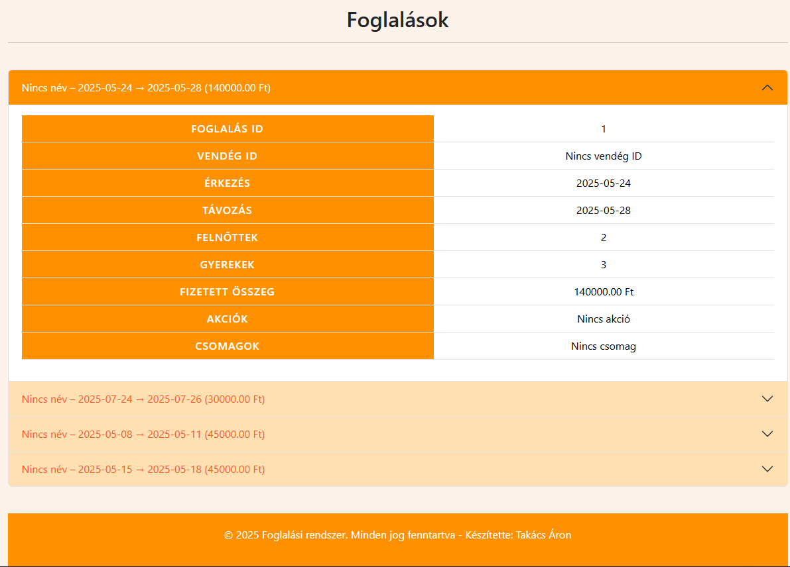
Reservations history / -2024
Filter Options: Users can filter bookings by:
Year, Month
Number of adults and children
Package and Promotion
Make some statics

Slide 12
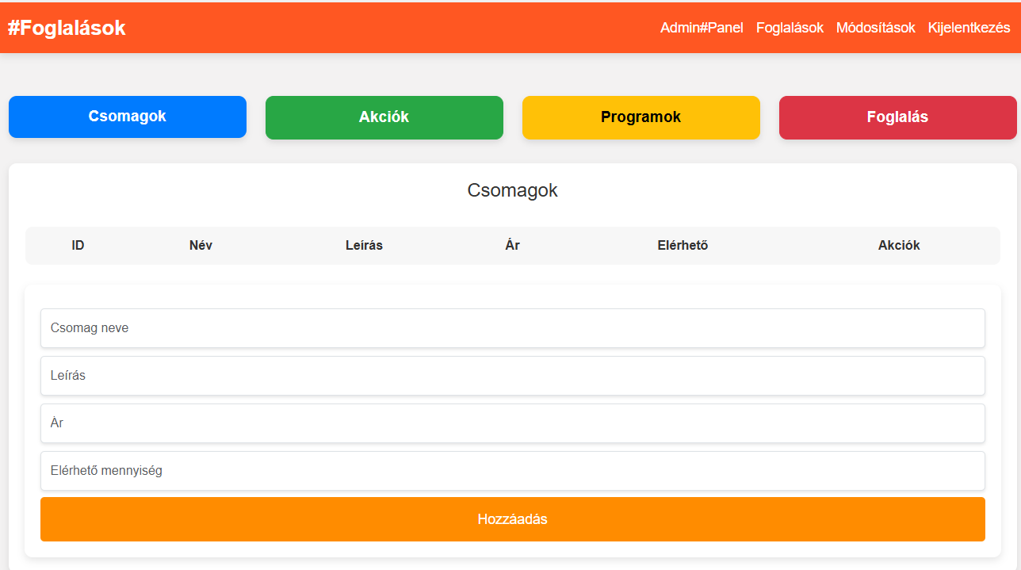
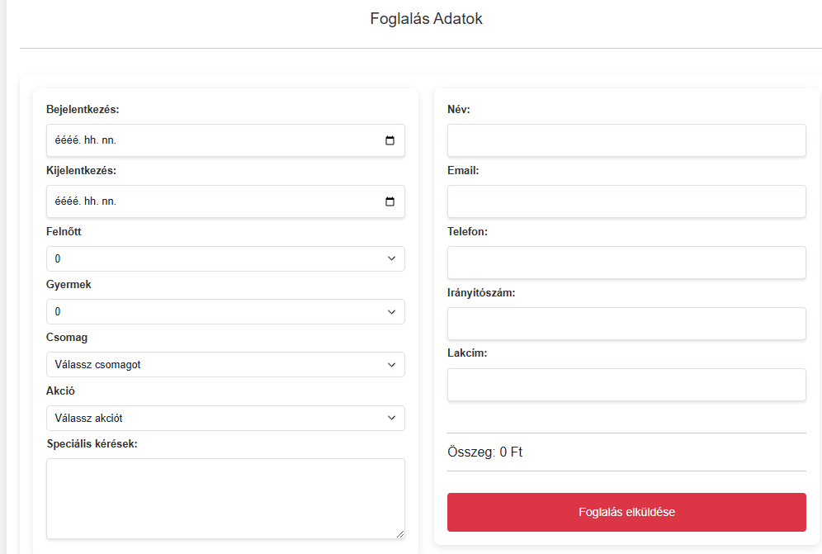
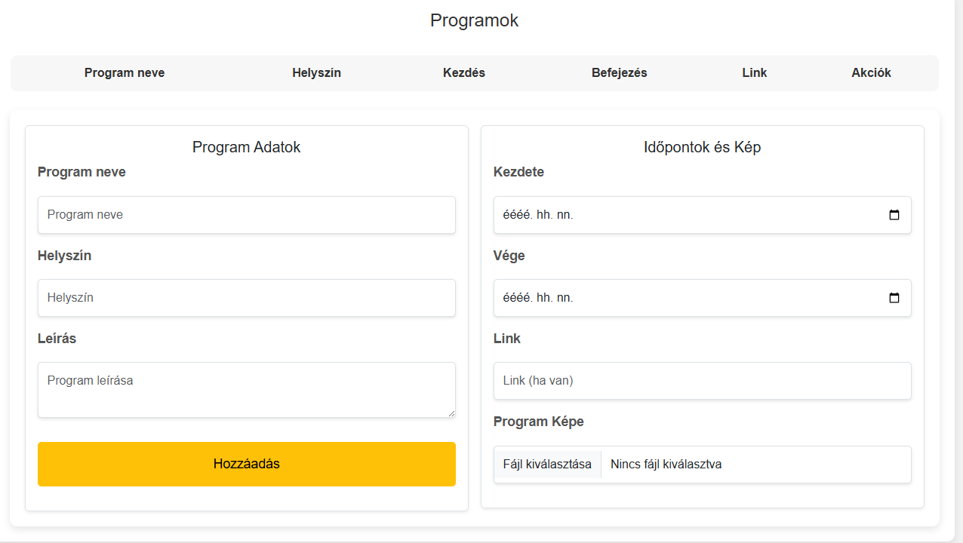
Admin Modification Panel
The purpose: the page is to add, modify, or delete new packages, promotions, programs, and potential bookings.

Slide 13
Thank you for your kind Attention☺
Created by: Lóczi Gergő, Takács Áron

